Slide 1
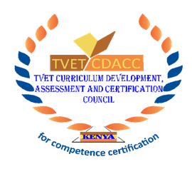

Course: ICT Unit of Learning: System Analysis and Design
Learning Outcome No2: Approaches to system Development and Project planning

Slide 2
Learning Outcome 2 : System development approaches
Introduction;
In this Chapter we are going to discuss about system development life cycle and it's models and phases.
The systems development life cycle (SDLC), also referred to as the application development life-cycle, is a term used in systems engineering, information systems and software engineering to describe a process for planning, creating, testing, and deploying an information system.

Slide 3
Learning Outcome:
Trainee’s Guide

Slide 4
Learning Outcome No 2:Approaches to system development and project planning
Topic 1: System development Approaches

Slide 5
Topic 1:System development Approaches
There are three approaches to System development that is;
The Linear approaches
This takes specific activities and represents them as separate phases.
After each stage is defined it is signed off and then development goes on to the next stage.
b) The Iterative approaches
This approach interleaves the activities of specification, development & validation.
An initial system is rapidly developed from very abstract specification.

Slide 6
Topic 1:System development Approaches
c) Component-based software development
This technique assumes that parts of the system already exists and the rest needs to be planned for and designed.
The system development process focuses on integrating these parts rather than developing them from scratch.
Components based approaches break down the scope of the large system into modules which are generic and can be reused into other sections of the developed information system.

Slide 7
Learning Outcome No 2:Approaches to system development and project planning
Topic 1: System development methodolies

Slide 8
Topic 2:System development methodolies
A system development methodology refers to the framework that is used to structure, plan, and control the process of developing an information system.
(SDLC) is also known as System development life cycle.
(SDLC) is a conceptual model which includes policies and procedures for developing or altering systems throughout their life cycles.
The systems development lifecycle concept applies to a range of hardware and software configurations, as a system can be composed of hardware only, software only, or a combination of both.
There are usually six stages in this cycle: analysis, design, development and testing, implementation, documentation, and evaluation.

Slide 9
Learning Outcome No2:Approaches to system Development and Project planning
Topic 3: System development life cycle models

Slide 10
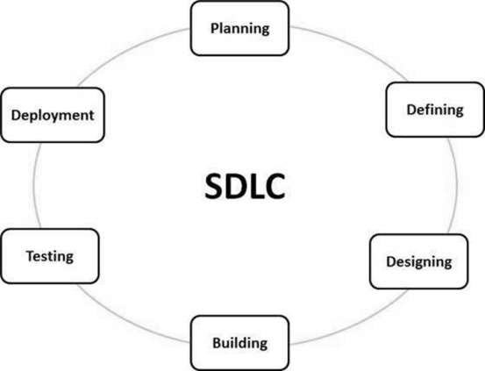
Topic 3:System development life cycle models

Slide 11
Topic 3:System development life cycle models
System development lifecycle methodologies
SDLC MODELS
Agile
Lean
Waterfall
Iterative
Spiral
v-model

Slide 12
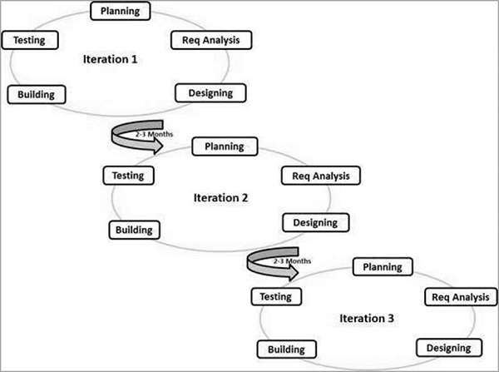
Topic 3:System development life cycle models
1. Agile model
Agile SDLC model is a combination of iterative and incremental process models with focus on process adaptability and customer satisfaction by rapid delivery of working software product.
Agile Methods break the product into small incremental builds.

Slide 13
Topic 3:System development life cycle models
The advantages of the Agile Model are as follows −
Is a very realistic approach to software development.
Promotes teamwork and cross training.
Functionality can be developed rapidly and demonstrated.
Resource requirements are minimum.

Slide 14
Topic 3:System development life cycle models
The disadvantages of the Agile Model are as follows −
Not suitable for handling complex dependencies.
More risk of sustainability, maintainability and extensibility.
An overall plan, an agile leader and agile PM practice is a must without which it will not work.
Strict delivery management dictates the scope, functionality to be delivered, and adjustments to meet the deadlines.

Slide 15
Topic 3:System development life cycle models
2. Lean
The Lean model for software development is inspired by lean manufacturing practices and principles.
The seven Lean principles (in this order) are: eliminate waste, amplify learning, decide as late possible, deliver as fast as possible, empower the team, build integrity in, and see the whole.
The Lean process is about working only on what must be worked on at the time, so there’s no room for multitasking.

Slide 16
Topic 3:System development life cycle models
3. Waterfall
The Waterfall Model was the first Process Model to be introduced. It is also referred to as a linear-sequential life cycle model.
It is very simple to understand and use.
In a waterfall model, each phase must be completed before the next phase can begin and there is no overlapping in the phases.
The waterfall Model illustrates the software development process in a linear sequential flow. This means that any phase in the development process begins only if the previous phase is complete. In this waterfall model, the phases do not overlap.

Slide 17
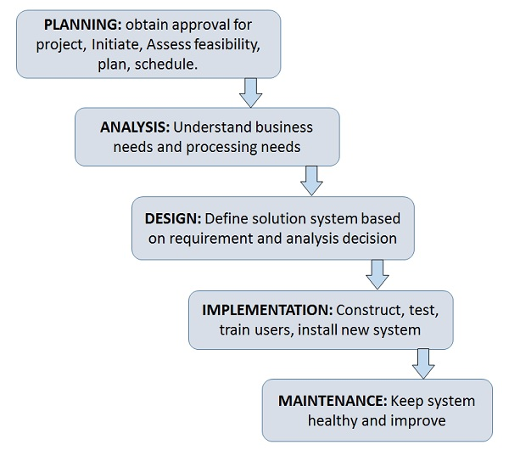
Topic 3:System development life cycle models
waterfall model

Slide 18
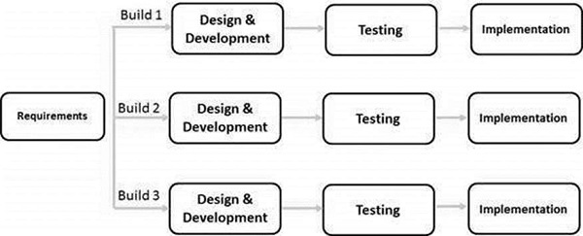
Topic 3:System development life cycle models
4. Iterative Model
The basic idea behind this method is to develop a system through repeated cycles (iterative) and in smaller portions at a time (incremental).
Iterative and Incremental development is a combination of both iterative design or iterative method and incremental build model for development.
"During software development, more than one iteration of the software development cycle may be in progress at the same time."
This process may be described as an "evolutionary acquisition" or "incremental build" approach."

Slide 19
Topic 3:System development life cycle models
Iterative Model - Application
Like other SDLC models, Iterative and incremental development has some specific applications in the software industry. This model is most often used in the following scenarios −
Requirements of the complete system are clearly defined and understood.
Major requirements must be defined; however, some functionalities or requested enhancements may evolve with time.

Slide 20
Topic 3:System development life cycle models
The advantages of the Iterative SDLC are as follows −
Some working functionality can be developed quickly and early in the life cycle.
Results are obtained early and periodically.
Parallel development can be planned.
Progress can be measured.

Slide 21
Topic 3:System development life cycle models
The disadvantages of the Iterative and Incremental SDLC Model are as follows −
More resources may be required.
Although cost of change is lesser, but it is not very suitable for changing requirements.
More management attention is required.
System architecture or design issues may arise because not all requirements are gathered in the beginning of the entire life cycle.

Slide 22
Topic 3:System development life cycle models
5. Spiral
The Spiral model is typically used for large projects. It enables development teams to build a highly customized product, and incorporate user feedback early on in the project
Each iteration starts by looking ahead to potential risks, and figuring out how best to avoid or mitigate them.

Slide 23
Topic 3:System development life cycle models
Spiral Model Application
The Spiral Model is widely used in the software industry as it is in sync with the natural development process of any product, i.e. learning with maturity which involves minimum risk for the customer as well as the development firms.
The following pointers explain the typical uses of a Spiral Model
When there is a budget constraint and risk evaluation is important.
For medium to high-risk projects.

Slide 24
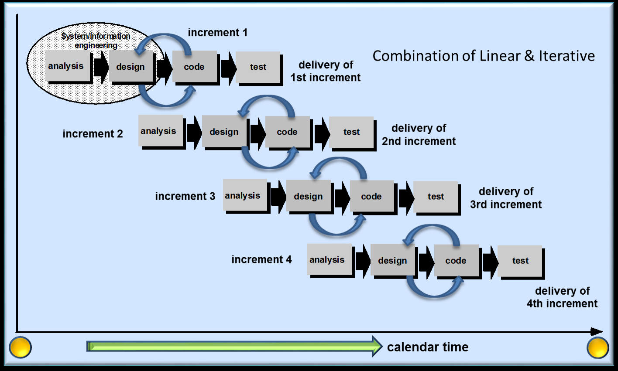
Topic 3:System development life cycle models
Spiral model

Slide 25
Topic 3:System development life cycle models
The advantages of the Spiral SDLC Model are as follows −
Changing requirements can be accommodated.
Allows extensive use of prototypes.
Requirements can be captured more accurately.
Users see the system early.
The disadvantages of the Spiral SDLC Model are as follows −
Management is more complex.
End of the project may not be known early.
Not suitable for small or low risk projects and could be expensive for small projects.
Process is complex

Slide 26
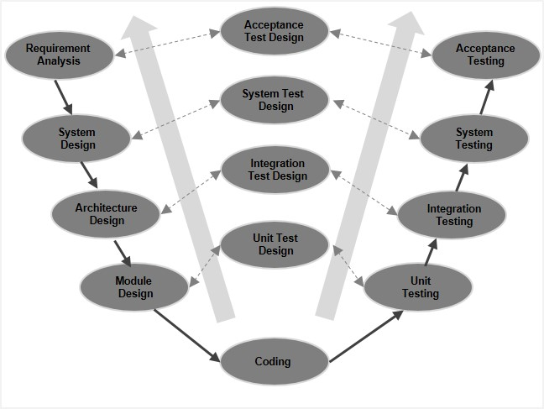
Topic 3:System development life cycle models
The V-model
In thisSDLC model execution of processes happens in a sequential manner in a V-shape. It is also known as Verification and Validation model.
This means that for every single phase in the development cycle, there is a directly associated testing phase.

Slide 27
Topic 3:System development life cycle models
V- Model ─ Application
V-Model application.
Requirements are well defined, clearly documented and fixed.
Product definition is stable.
Technology is not dynamic and is well understood by the project team.
There are no ambiguous or undefined requirements.

Slide 28
Topic 3:System development life cycle models
The advantages of the V-Model method are as follows −
This is a highly-disciplined model and Phases are completed one at a time.
Works well for smaller projects where requirements are very well understood.
Simple and easy to understand and use.
Easy to manage due to the rigidity of the model. Each phase has specific deliverables and a review process.
The disadvantages of the V-Model method are as follows −
High risk and uncertainty.
Not a good model for complex and object-oriented projects.
Poor model for long and ongoing projects.
Not suitable for the projects where requirements are at a moderate to high risk of changing.

Slide 29
Learning Outcome No2:Approaches to system Development and Project planning
Topic 4: Activities in SDLC

Slide 30
Topic 4: Activities involved in SDLC
SDLC Activities
SDLC provides a series of steps to be followed to design and develop a software product efficiently. Includes the following steps:
Communication
requirem gathering
Feasibility study
System Analysis
Software Design
coding
intergration
implementation
operations & Maintenance
Disposition

Slide 31
Topic 4: Activities involved in SDLC
Communication
This is the first step where the user initiates the request for a desired software product. He contacts the service provider and tries to negotiate the terms. He submits his request to the service providing organization in writing.
Requirement Gathering
The requirements are contemplated and segregated into user requirements, system requirements and functional requirements.
The requirements are collected using a number of practices as given -
studying the existing or obsolete system and software,
conducting interviews of users and developers,
referring to the database or
collecting answers from the questionnaires.

Slide 32
Topic 4: Activities involved in SDLC
Feasibility Study
At this step the team analyzes if a software can be made to fulfill all requirements of the user and if there is any possibility of software being no more useful.
System Analysis
System analysis includes Understanding of software product limitations, learning system related problems or changes to be done in existing systems beforehand, identifying and addressing the impact of project on organization and personnel etc. T
Coding
This step is also known as programming phase. The implementation of software design starts in terms of writing program code in the suitable programming language and developing error-free executable programs efficiently.

Slide 33
Topic 4: Activities involved in SDLC
Testing
An estimate says that 50% of whole software development process should be tested. Errors may ruin the software from critical level to its own removal.
Software testing is done while coding by the developers and thorough testing is conducted by testing experts at various levels of code such as module testing, program testing, product testing, in-house testing and testing the product at user’s end.
Integration
Software may need to be integrated with the libraries, databases and other program(s). This stage of SDLC is involved in the integration of software with outer world entities.
Implementation
This means installing the software on user machines.
Operation and Maintenance
This phase confirms the software operation in terms of more efficiency and less errors. If required, the users are trained on, or aided with the documentation on how to operate the software and how to keep the software operational.
The software is maintained timely by updating the code according to the changes taking place in user end environment or technology.

Slide 34
Topic 4: Activities involved in SDLC
Disposition
As time elapses, the software may decline on the performance front.
It may go completely obsolete or may need intense upgradation.
Hence a pressing need to eliminate a major portion of the system arises.
This phase includes archiving data and required software components, closing down the system, planning disposition activity and terminating system at appropriate end-of-system time.

Slide 35
Learning Outcome No2:Approaches to system Development and Project planning
Topic 5: Phases in SDLC

Slide 36
Topic 5:Phases in SDLC
Phases of the Software Development Life Cycle
Stage 1 – Planning
This is known as the planning stage. It is the most important phase of the entire SDLC from the perspective of project managers and stakeholders.
The planning stage answers questions such as:
How the software will be used?
What data will serve as the input of the software?
Stage 2 – Analysis
Once all the requirements are collected, it’s time to analyze those requirements for feasibility and validity.
Simply stating, it is studied whether it will be possible to add the requirements to the software or not.
Stage 3 – Designing
This stage includes the designing of requirements specified in the very first phase of the SDLC. In addition to assisting in specifying hardware as well as system requirements, Software Design also helps in defining the overall software architecture. During the designing phase, testers are required to come up with an apt testing strategy.

Slide 37
Topic 3:System development life cycle models
Stage 4 – Development & Testing
While some development teams consider this phase as a single unit, others prefer to break it into two sub-phases.
Once the system design documentation is complete, the whole task is divided into modules or units. Now, the actual coding starts.
Because this phase includes coding, it is the most important phase of the SDLC for the developer team. Moreover, this is the longest phase of the entire software development lifecycle. Once the code is fully developed, testing of the same is carried against the requirements.

Slide 38
Topic 5:Phases in SDLC
Stage 5 – Implementation
Also known as the deployment phase, the implementation phase is carried out right after the successful testing of the software product. It is simply delivering the software to the end-user or installing it onto the customer’s system(s).
Stage 6 – Maintenance
At last, the maintenance phase is executed. This phase deals with the problems experienced by the customers/end-users that they experience while using the developed software.

Slide 39
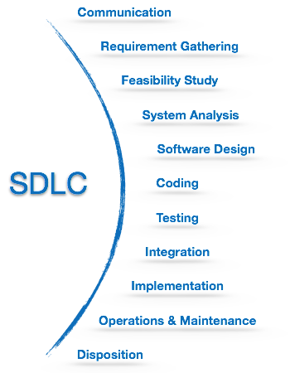
Topic 5:Phases in SDLC

Slide 40
Learning Outcome No2:Approaches to system Development and Project planning
Topic 6 : Project planning concept

Slide 41
Topic 6: Project planning concepts
1. Project Initiation Phase
Here you need to define what’s the goal of a project, and it’s success criteria.
2. Concept Development Phase
Follow the design-first approach.
It shouldn’t be fully detailed. But it should provide a framework for future Requirement Definition activities.
3. Planning Phase
project planning boils down to:
Identifying project scope
Estimates of time and costs
Setting milestones

Slide 42
Topic 6: Project planning concepts
4. Requirements Definition Phase
In this phase you can use all the available options to define requirements:
Brainstorming
Interviews
Focus Groups
Questionaries and Surveys
5. Design Phase
During this phase, you need to analyze the collected requirements. After that, develop an architecture that’ll support them.

Slide 43
Topic 6: Project planning concepts
6. Development Phase
In this phase, you get into the day-to-day execution of the project plan. start coding.
7. Integration Phase
This phase usually requires a lot of collaboration. It can be time-consuming.
Puting together the code.
8. Testing Phase
This phase also referred to as Acceptance testing. Or final testing.You need to understand that you should be testing your application continuously from the beginning. Ideally, your application should be stable and without serious defects all the time.
9. Deployment Phase
The software doesn’t work without hardware. You need to set up servers, upload your application, connect it with all the other services and servers.

Slide 44
Topic 6: Project planning concepts
10. Maintenance Phase
The application’s maintained and supported throughout its whole lifetime. It’s a part of a product life cycle that goes beyond the project life cycle.

Slide 45
References.
Videos -
https://youtu.be/cY-3wdvbz6o
https://www.youtube.com/watch?v=ppZ3JIW0mxE
Links-
https://pmbasics101.com/7-essential-project-planning-concepts/

